Slide 1

Heart Disease Diagnostic Analysis

Slide 2
Introduction:
Heart disease, a leading cause of death worldwide, encompasses various conditions that affect the heart's structure and function.
Diagnosing heart disease accurately is critical for effective treatment and management.
The diagnostic process involves a combination of patient history, physical examinations, and a range of diagnostic tests.
This comprehensive approach helps identify the presence, type, and severity of heart disease, enabling healthcare providers to tailor treatment plans to individual needs.

Slide 3
DETAILS OF Data:
Age: age of the patient in years. Heart disease risk increases with age.
Sex: sex of the patient (1 = male, 0 = female). Males typically have a higher risk of heart disease compared to females.
Cp (chest pain type): type of chest pain experienced by the patient.0: typical angina,1: atypical angina,2: non-anginal pain,3: asymptomatic
Trestbps (resting blood pressure): the patient's resting blood pressure in mm hg. Higher blood pressure can indicate a higher risk of heart disease.
Chol (serum cholesterol): the patient’s serum cholesterol in mg/dl. High levels of cholesterol are associated with an increased risk of heart disease.
Fbs (fasting blood sugar): fasting blood sugar level (> 120 mg/dl means true; 1 = yes, 0 = no). Higher levels can be indicative of diabetes, which is a risk factor for heart disease.
Restecg (resting electrocardiographic results): results of the resting electrocardiogram.0: normal,1: having ST-T wave abnormality (T wave inversions and/or ST elevation or depression of > 0.05 mv),2: showing probable or definite left ventricular hypertrophy by estes’ criteria.

Slide 4
Thalach (maximum heart rate achieved): the highest heart rate achieved during exercise or stress testing. Lower values can indicate abnormal heart function. Exang (exercise induced angina): whether exercise-induced angina is present (1 = yes, 0 = no). Exercise-induced angina can be a sign of coronary artery disease. Oldpeak: st depression induced by exercise relative to rest. It indicates the level of stress on the heart. Slope (slope of the peak exercise st segment):0: upsloping,1: flat,2: down sloping Ca (number of major vessels colored by fluoroscopy): number of major vessels (0-3) colored by fluoroscopy. Higher numbers can indicate more severe heart disease. Thal: thalassemia blood disorder values.1: normal,2: fixed defect,3: reversible defect Target: presence of heart disease (1 = heart disease, 0 = no heart disease). This is the outcome variable in a heart disease dataset.

Slide 5
Main KPIs:
Analysis by age: age is a significant risk factor for heart disease, with the risk increasing as people get older.
Analysis by sex: Males typically have a higher risk of developing heart disease compared to females, though the risk for females increases post-menopause.
Overall analysis: This analysis focuses on all parameters that effects the heart disease diagnostic.

Slide 6
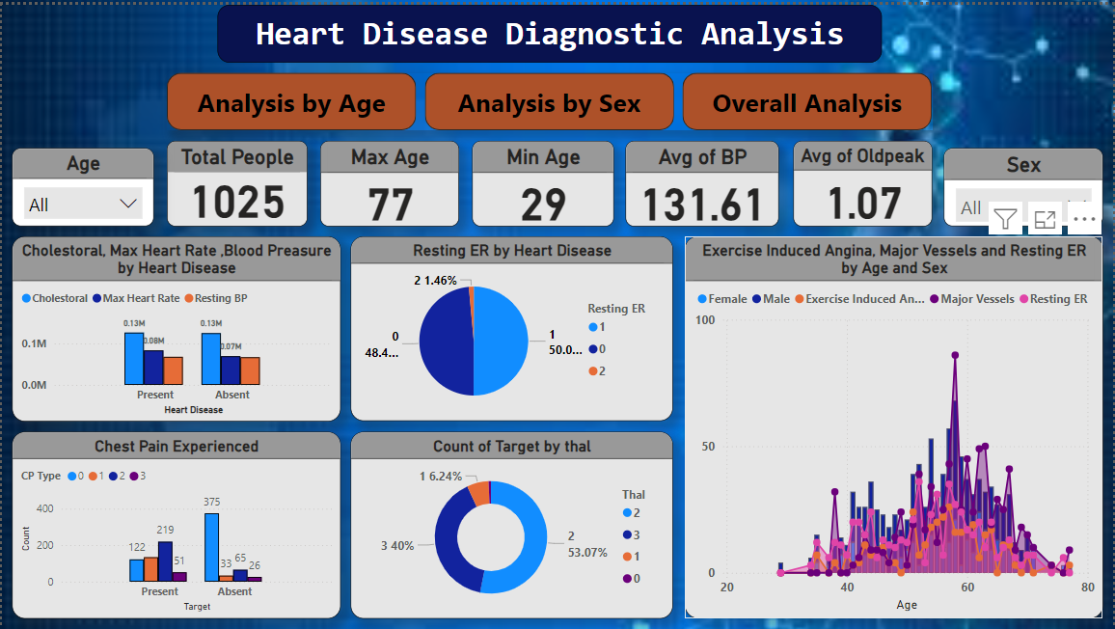
My Dashboard:

Slide 7
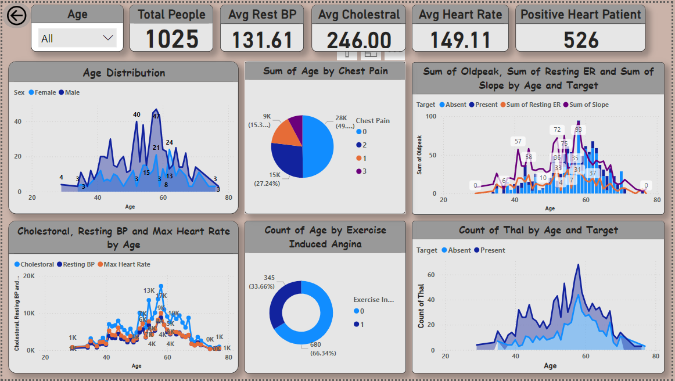
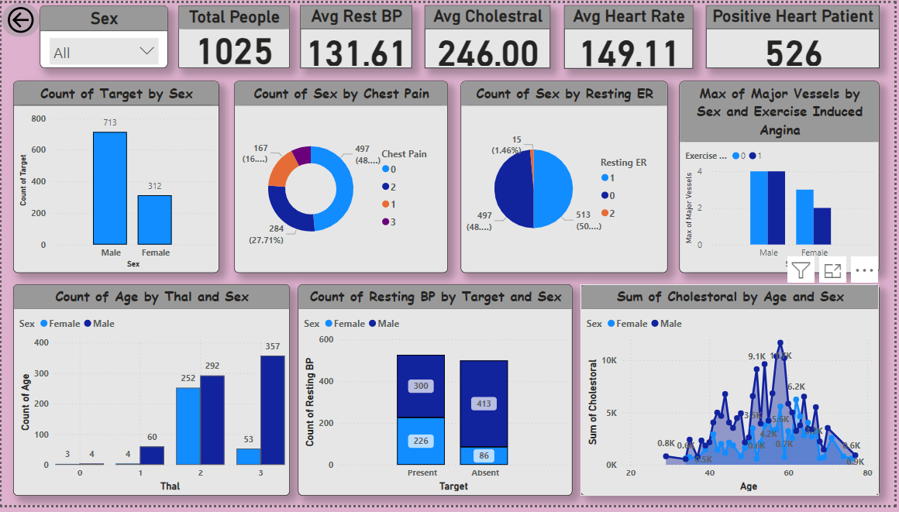
My design:

Slide 8
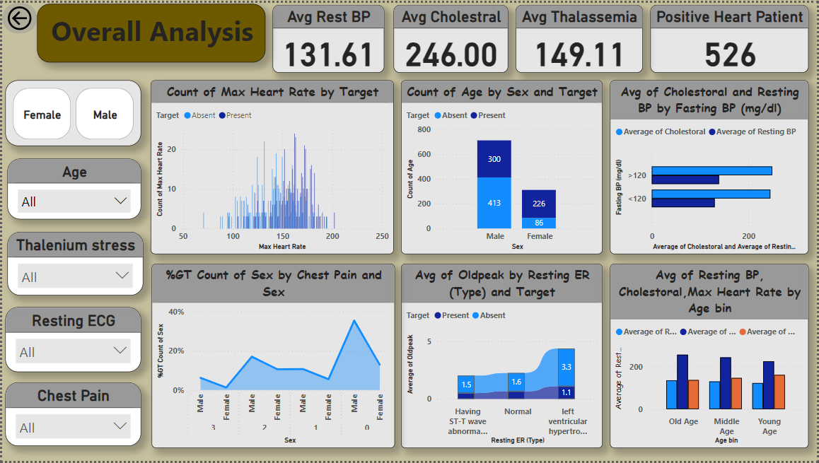

Slide 9
Thank you

